Slide 1

Fundamentals of Database
Biomedical Research Database System
Prepared by: Menatalla Ahmed Osman & Hana Hisham Saad

Slide 2

Project Overview
The project designs a biomedical research database.
It stores authors, research papers, journals, publishers, and biomedical fields.
The goal is to organize scientific information in a structured way.
SQL is used to create tables, insert data, and run queries.

Slide 3
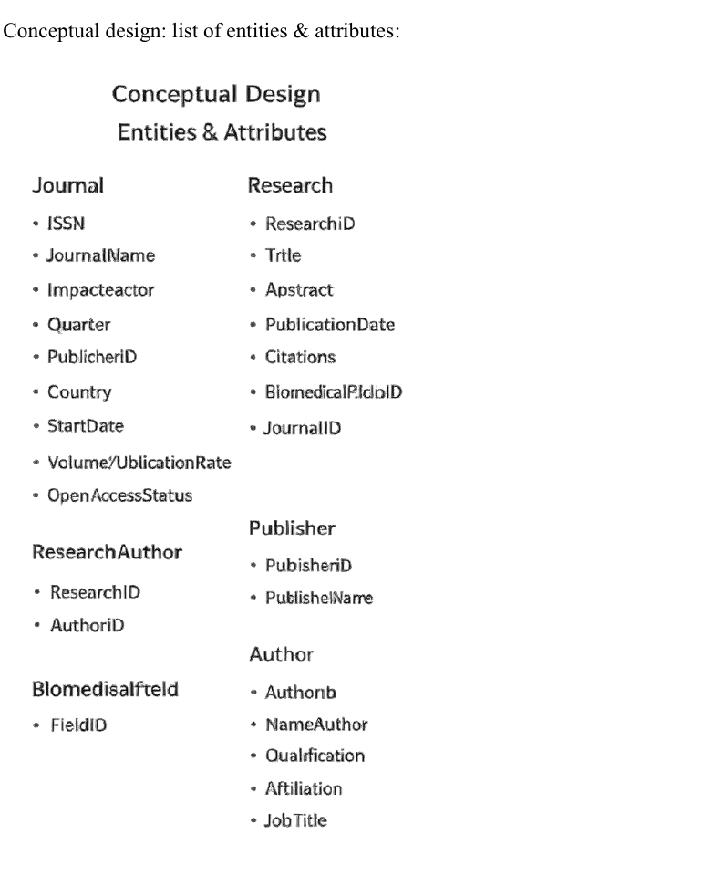
Conceptual Design
Main entities: Author, Research, Journal, Publisher, BiomedicalField.
Each entity has its own attributes.
Relationships show how the entities connect.
Many-to-many relationships are handled with junction tables.

Slide 4
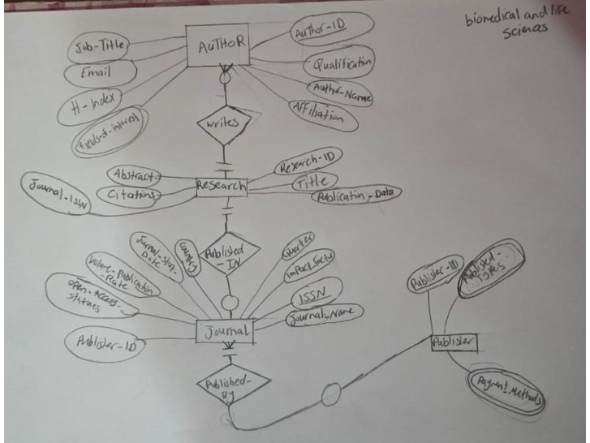
ER Diagram
The ER diagram shows the relationships between the entities.
Primary keys uniquely identify each record.
Foreign keys connect the tables together.
It also shows participation and cardinality constraints.

Slide 5
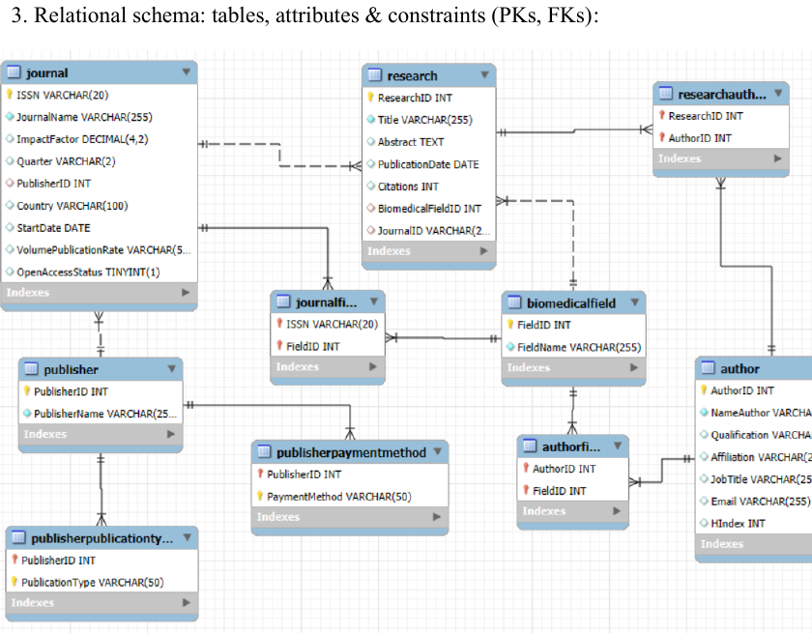
Relational Schema
The ER model is converted into tables.
Primary keys keep each row unique.
Foreign keys enforce referential integrity.
Junction tables store many-to-many relationships.

Slide 6
DDL Operations
CREATE DATABASE builds the biomedical database.
CREATE TABLE defines structure, data types, and constraints.
PRIMARY KEY, FOREIGN KEY, UNIQUE, and NOT NULL protect the data.
Different data types are used for text, numbers, dates, and yes/no values.

Slide 7

DML Operations
INSERT statements add sample records into each table.
SELECT retrieves information from the database.
UPDATE changes existing data when needed.
JOIN combines related tables into one result.

Slide 8
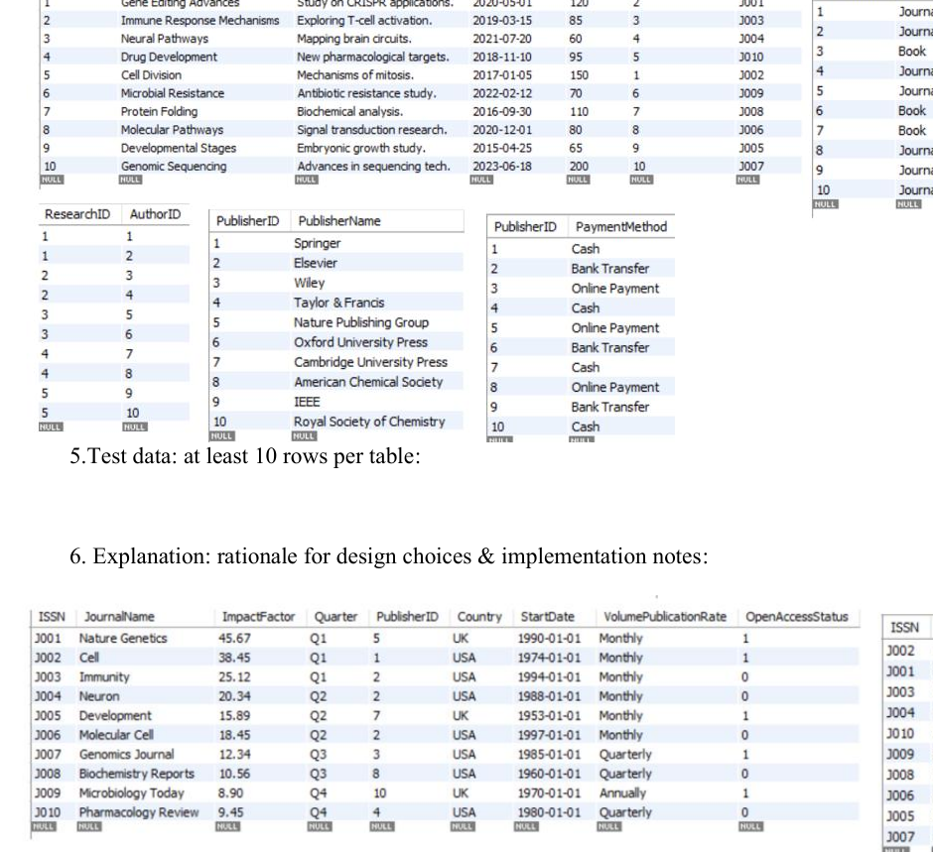
Queries and Views

Slide 9

Design Rationale
Normalization reduces redundancy.
Junction tables make the design scalable.
Separate tables make the database flexible.
Constraints improve consistency and accuracy.

Slide 10

Conclusion
The database organizes biomedical research data clearly.
SQL was used to build and test the system.
The design supports consistency, scalability, and future expansion.

